Slide 1
Phishing Awareness
Training
By Samyak Santosh Jadhav – CodeAlpha Cybersecurity Internship

Slide 2
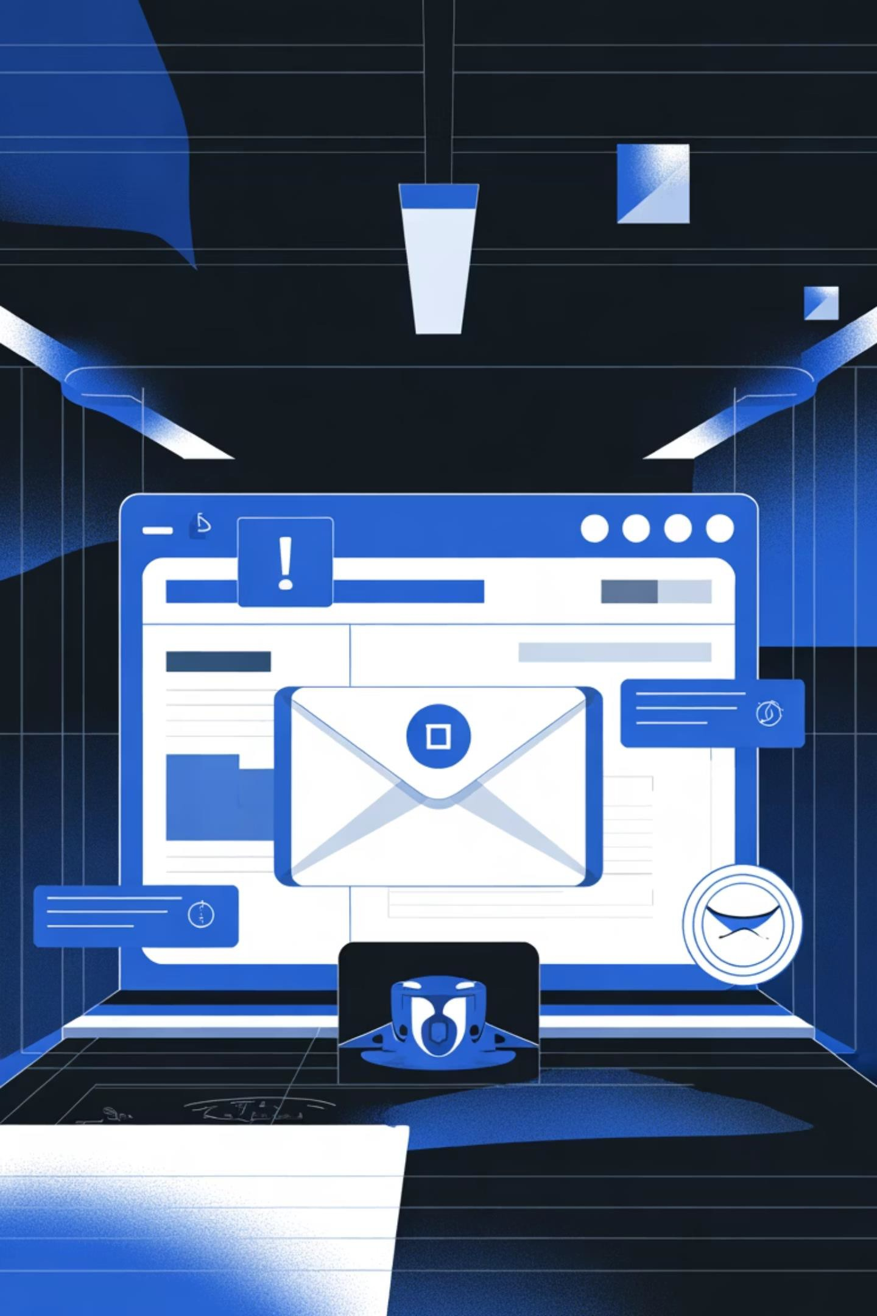
What is Phishing?
Definition
Phishing is a cyber attack where attackers trick users into revealing sensitive data.
Methods
Usually done through fake emails, websites, or text messages.
Example
"Your account is locked — click here to verify."

Slide 3
Types of Phishing
1
Email Phishing
Fake emails that look official.
2
Spear Phishing
Targeted attacks on specific people.
3
Smishing
Phishing via SMS or WhatsApp.
4
Vishing
Voice phishing over calls.
5
Clone Phishing
Copying a real message and inserting a malicious link.

Slide 4
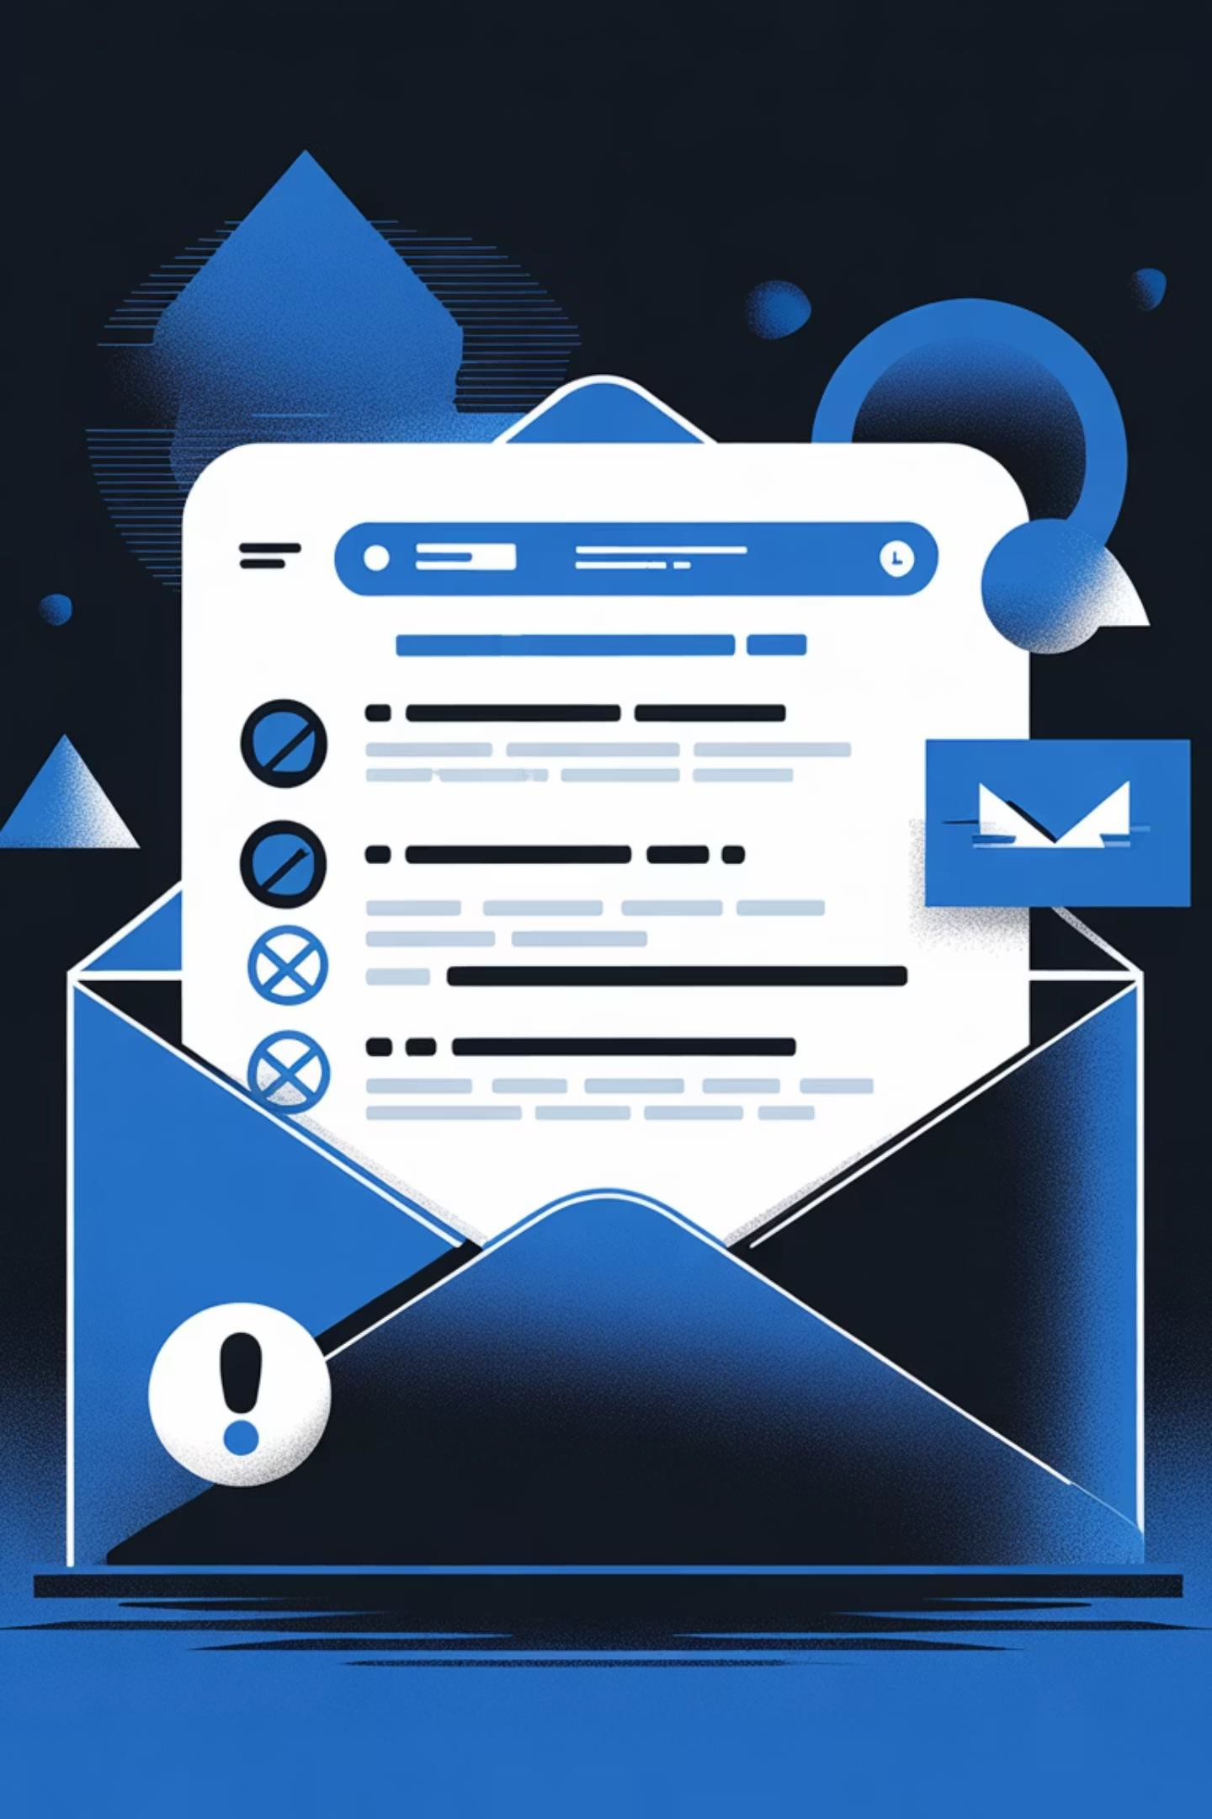
How to Identify a Phishing Email
Check the sender's email ID
Look for spelling errors and suspicious addresses.
Hover over links before clicking
Check real URLs to verify they lead to legitimate sites.
Avoid urgent or fear-based language
Watch out for messages like "Your account will be closed".
Don't open unknown attachments or links
Suspicious files can contain malware or malicious code.

Slide 5
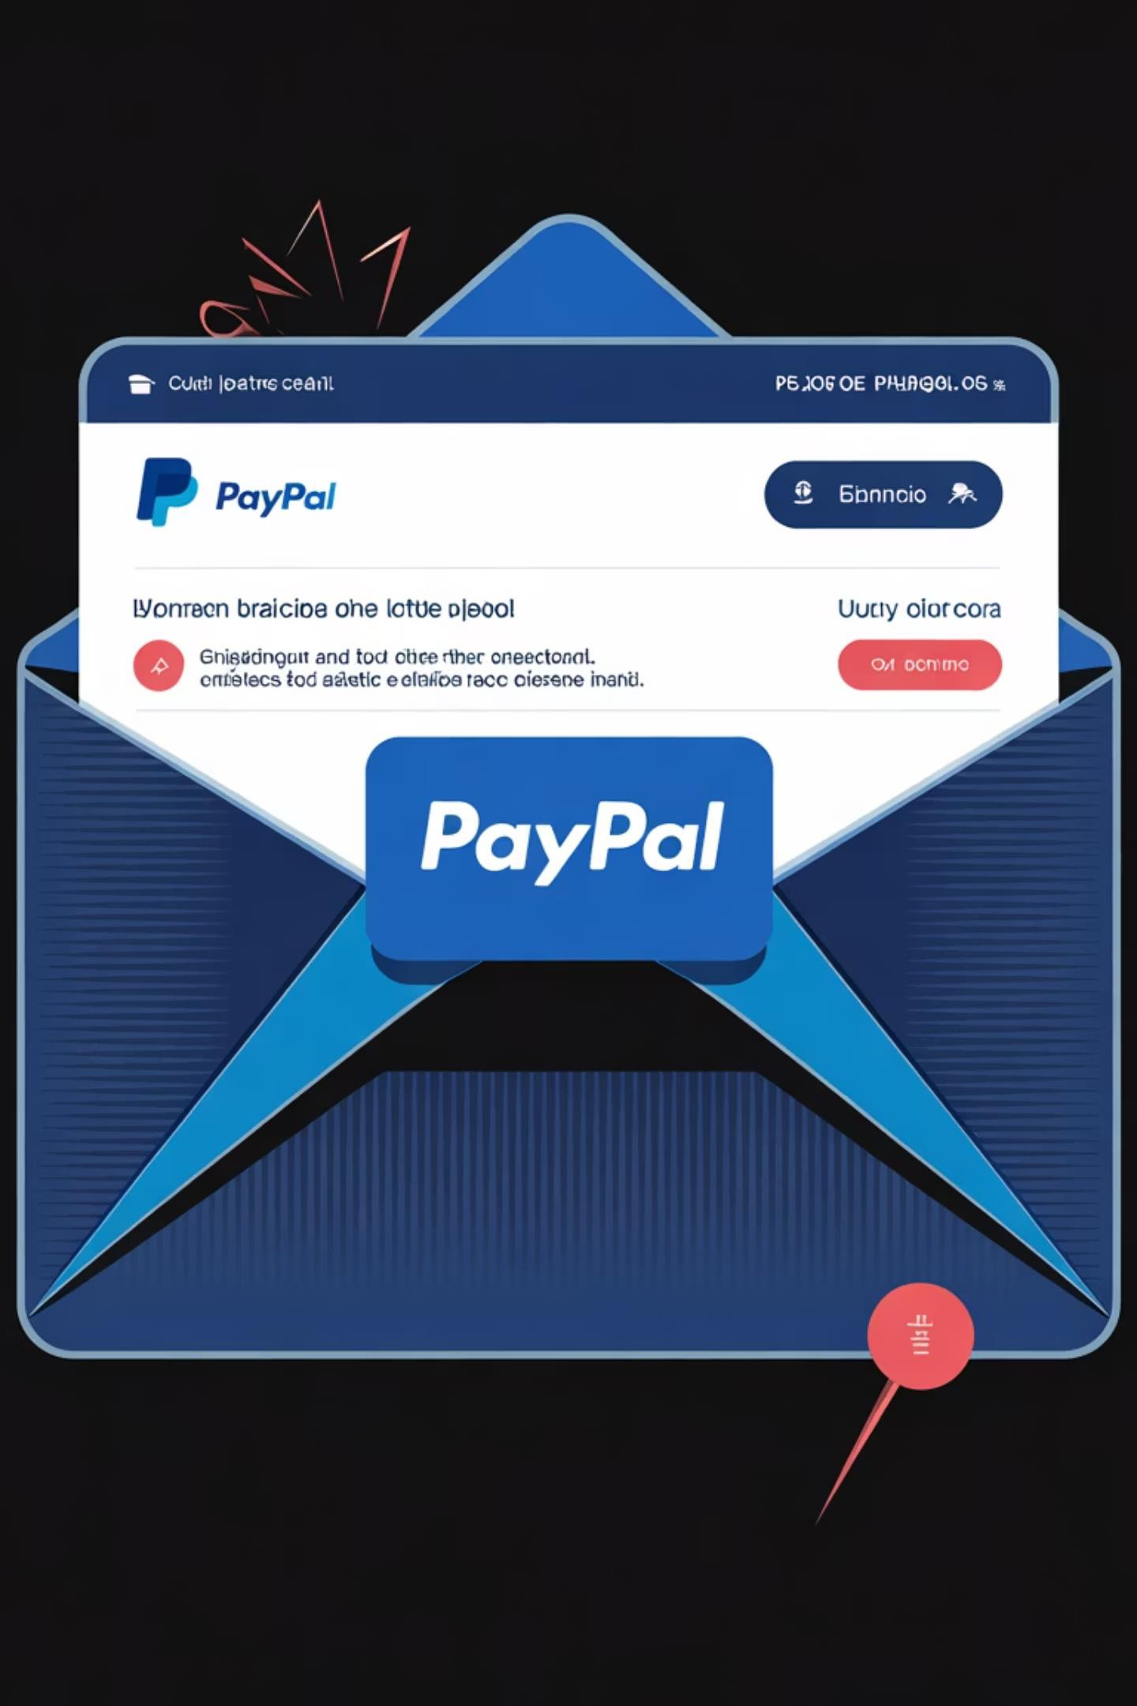
Real Example
Example Email:
"PayPal: We noticed unusual activity on your account. Click here to confirm."
What's suspicious:
Unknown sender address
Poor grammar
Fake link (does not lead to official PayPal site)

Slide 6
Prevention Tips
Secure Your Access
Keep Systems Updated
Verify Communications
Do not click unknown links or
attachments
Use multi-factor authentication (MFA)
Never share OTPs or passwords
Keep antivirus software updated
Keep browsers updated
Verify messages by contacting the
organization directly

Slide 7
How Organizations Prevent Phishing
01
Employee Awareness Training
Conduct employee awareness training regularly to educate staff about phishing threats.
02 03
Email Security Tools Incident Response
Use email filters and authentication tools Report phishing attempts immediately to (SPF, DKIM, DMARC) to prevent spoofed the IT/Security team for quick action. emails.

Slide 8
Mini Quiz
1
Question 1
What is phishing?
2
3
Question 2
What are the signs of a phishing email?
Question 3
Should you share OTPs or passwords through calls or messages?

Slide 9

Conclusion
Common Threat
Phishing is one of the most common cyber threats, but it's preventable.
Think Before You Click
Always think before you click on suspicious links or attachments.
Your Best Defense
Awareness and caution are your best defense against phishing attacks.

Slide 10
References
www.phishing.org
www.cyber.gov.in
www.cisa.gov
Stay vigilant. Stay secure.

